Slide 1
Overview Of Software And Applications

Slide 2
Overview Of Software And Applications
Software, or programs, consists are electronic instructions that tell the computer how to perform a task.
software is any set of machine-readable instructions that directs a computer's processor to perform specific operations.
Software is a set of programs, which is designed to perform a well-defined function.
  A program is a sequence of instructions written to solve a particular problem.
Software is needed to control hardware and to turn it into a useful machine.
There are two types of software
  System Software
  Application Software
Systems software: coordinates the activities and functions of hardware and programs

Slide 3
Types of Software
There are two types of software
  1. System software – which controls computer system.
  2. Application software – which carries out specific tasks for an organization or an individual user.
  Application software: helps users solve particular problems
System software must be placed on a computer system before application software can be used.

Slide 4
System Software
Designed to operate and control computer hardware and to provide a platform for running application software.
Programs that support the execution and development of other programs
A user is normally not aware of the system software.
Technical users such as system administrator spend most of their time working with system software.
System software works on the background when a user is doing something useful with application software, for example, when printing a document.
Types of systems software
    Operating systems
    Utility programs

Slide 5
Operating Systems (OS)
A set of programs that controls the computer hardware and acts as an interface with application programs
OS acts as an intermediary (in-between) between application and hardware.
The core of the system software is the operating system.
  Windows is an operating system that is widely used.
  Other operating systems are Linux, Unix, MAC OS., Windows Server
Operating system is not a single program but a collection of programs, each of which carries a specific task.
Extra programs can be added to the main operating system.
For example, when a new printer is added to the system, printer drivers has to be installed to enable operating system communicate with the device.

Slide 6
Activities performed by the operating system
  Perform common computer hardware functions
  Provide a user interface and input/output management
  Provide a degree of hardware independence
  Manage system memory
  Manage processing tasks
  Provide networking capability
  Control access to system resources
  Manage files
Operating system is designed to make the computer system as efficient as possible.

Slide 7
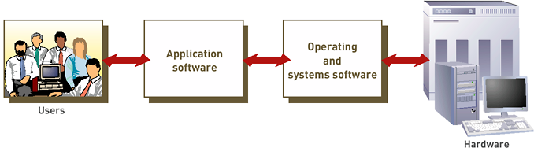
Operating Systems (continued)
The role of Systems Software –interface between users, application software and hardware
The Role of Systems Software

Slide 8
Operating Systems (continued)
OS acts as an intermediary between application and hardware
OS converts basic request into a set of details instruction that the hardware requires
Common hardware functions (e.g.)
  Get input from keyboard or some other input device
  Retrieve data from disks
  Store data on disks
  Display information on a monitor or printer

Slide 9
Operating Systems Functions
User interface and input/output management
      Any operation, program, or device that transfers data to or from a computer.
      I/O devices are printers, hard disks, keyboards, and mouses.
  User interface: allows individuals to access and command computer system
  Command-based user interface: requires that text commands be given to the computer to perform basic activities
  Graphical user interface (GUI): uses icons and menus displayed on screen to send commands to the computer system

Slide 10
Operating Systems Functions (continued)
Hardware independence
  Application program interface (API): allows applications to make use of the operating system
Memory management
  Control how memory is accessed and maximize available memory and storage

Slide 11
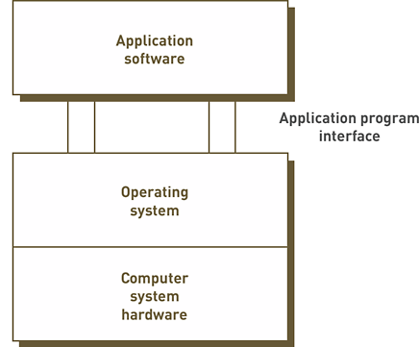
Operating Systems Functions (continued)
Application Program Interface Links Application Software to the Operating System

Slide 12
Operating Systems (continued)
Processing tasks
  Multitasking: more than one program can run at the same time
  Time-sharing: allows more than one person to use a computer system at the same time
  Scalability: ability of the computer to handle an increasing number of concurrent users smoothly
Networking capability
  OS provides features and capabilities that help users in connecting to a computer network

Slide 13
Operating Systems (continued)
Access to system resources and security
  Protection against unauthorized access
  Logins and passwords
File management
  Ensures that files in secondary storage are available when needed and that they are protected from access by unauthorized users

Slide 14
Current Operating Systems (continued)
Microsoft PC operating systems
  PC-DOS and MS-DOS: early, command-driven OSs
  Windows XP: greatly improved stability and security over previous versions of Windows
  Vista: latest version of Windows
  Windows 7
  Windows 8
  Windows 10
  Windows Server 2008, 2012

Slide 15
Current Operating Systems (continued)
Apple operating systems
  Provide cutting edge tools in graphics and music not available from Microsoft
  Mac OS X
    Jaguar (OS X.2)
    Panther (OS X.3)
    Tiger (OS X.4): support for 64-bit computing, Dashboard, Spotlight, etc.

Slide 16
Current Operating Systems (continued)
Linux
  Developed by Linus Torvalds in 1991
  Open-source product
  Only the kernel of an OS
  Several distributions available with capabilities/applications that form a complete OS
    Examples: Red Hat Linux, Caldera OpenLinux, Pinguy

Slide 17
Workgroup Operating Systems
Windows Server
UNIX
NetWare
Red Hat Linux
Mac OS X Server

Slide 18
Operating Systems for Small Computers, Embedded Computers, and Special-Purpose Devices
Palm OS
Windows Embedded
Windows Mobile
Android

Slide 19
Application Software
Application software is a program or group of programs designed for end users.
Applications are programs written to carry out a specific task or set of tasks,
  for example: word processors, spreadsheets, accounting packages, media players and games, hospital patient record system, Internet browser.
Application programs interact with systems software; systems software then directs computer hardware to perform the necessary tasks
For computer systems to be useful they must have application software.
Application software can be used for many purposes.
Software may be bought ready-made or may be designed specifically for an organization.

Slide 20
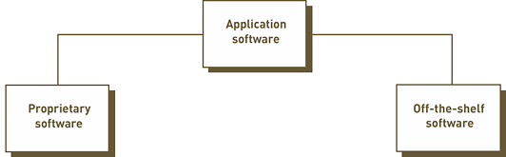
Overview of Application Software (continued)
Types of Application Software

Slide 21
Overview of Application Software
Two Types of Application software
Proprietary software/custom-written/bespoke
  a program for a specific application developed and owned by a single company e.g
  Sometimes an organization will have application software developed to meet the needs of an organisation - bespoke.
  This is known as bespoke software.
Off-the-shelf software: existing software program that is purchased e.g. MS Office

Slide 22
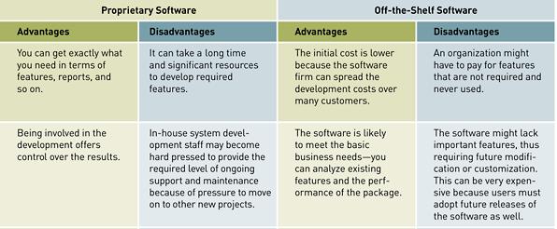
Overview of Application Software (continued)
A Comparison of Proprietary and Off-the-Shelf Software

Slide 23
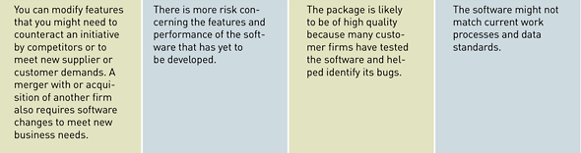
Overview of Application Software (continued)
A Comparison of Proprietary and Off-the-Shelf Software (continued)

Slide 24
Activities that might be used in an org. using Application software:
1. Carry out business transactions such as dealing with customer orders for mail order company, sending out mobile phone bills, booking facilities in health club or managing bank accounts.
2. Handle communication such as access to Internet and internal Emails.
3. Manage finances
4. Present information to an audience, whether in printed or electronic form.
5. Create and manipulate images
6. Manage projects
7. Design products.

Slide 25
Application software are also used outside office environment for many purposes such
  as playing games, recording music, genealogy and most of the other leisure pursuits.
In many cases, an organization will find that office applications software meet their needs perfectly well.

Slide 26
Office Application Software:
This software can be used for many different tasks in business and at home.
Anyone can buy this software, so it is designed to meet the needs of a wide range of users.
This is ready made software, hence can be installed and used immediately.
It is normally a complete package.
A package is a collection of programs which form one application
An installer is able to choose which components to install.
Office software packages are available for word processing, spreadsheet, database management, graphics (drawing and painting) and presentation graphics.

Slide 27
1. Word Processing
They can create standard documents, such as letters which they can use more than once with only minor changes.
They have reduced time taken to produce standard documents and have reduced staff cost.
Examples of word processors are: word perfect, lotus word pro or Microsoft word.
They have additional features which can be used to create email messages, web pages or mailing labels.

Slide 28
Spreadsheet
This is laid out as a very large table consisting of many cells.
Each cell can hold a value of a formula.
A formula can carry out calculations based on values in other cells.
Each cell can be formatted to hold data of specific type such as a number, date or simple text.
Spreadsheets also include graphing and charting functions, which will generate charts using data in the cells.
Spreadsheets can be interactive, allowing users to enter “what if” queries.
Many users have discovered that spreadsheets can also be used to print forms and other documents that need cells or tables.
Examples of spreadsheets are lotus 1,2,3 and Microsoft excel.

Slide 29
3. Database Management System
These structure and organize data used in databases
They are used in business to store data about stock in shops or factory, orders from customers, orders sent to suppliers, case notes (for doctors, social workers etc.), personnel (employee), mailing list or log sheets.

Slide 30
4. Graphic Software:
Graphics cover images stored in digital form.
They include photos that have been scanned or downloaded from digital camera or images drawn using graphical software.
Examples include photo editor or paint applications in Windows.
Graphics can be used in business to edit images to be used for stationery such as logos, publicity material (leaflets, brochure, posters) or web pages.

Slide 31
5. Presentation Software.
These are used to provide an illustration for talks or lectures.
They offer many useful templates, which can be customized by addition of your own text or images.
Examples include Microsoft power point and Lotus Freelance which can be used to create slides that can be projected directly from a computer to a screen and to print notes for the speaker and the audience.

Slide 32
6. Desktop Publishing:
Individual contributions to a newspaper can be sent to the editors system who can import them to page layout.
Stories headings and images can be easily edited and moved around to fit the space.
Once ready, it can be either printed directly or sent, still in electronic form to produce a plate for large scale printing.
On a small scale it can be used to arrange text or images on a page for a notice, leaflet or some other kind of publicity.
Examples include Adobe PageMaker or Microsoft publisher
These can be used to publish newsletters, notices, leaflets, publicity material or invitation.

Slide 33
7. Games Software:
Games are widely enjoyed in homes.
They can also be useful in educational context, where children can learn and explore ideas through the medium of games.
8. Communication Software:
People working in industry and commerce need to communicate with each other.
ICT can be used to support communication.
The main software applications for communication are web browsers and email.

Slide 34
Utility Programs
A program that performs specific tasks related to managing system resources.
Help to perform maintenance or correct problems with a computer system.
Utility software is system software designed to help analyze, configure, optimize or maintain a computer.
Operating systems contain a number of utilities for managing disk drives, printers, and other devices.
Common types of utility programs:
  Anti-virus - utilities scan for computer viruses.
  Backup software - can make copies of all information stored on a disk and restore either the entire disk.
  Data compression - utilities output a shorter stream or a smaller file when provided with a stream or file.
  File managers - performing routine data management tasks, such as deleting, renaming, moving, copying, merging, generating and modifying data sets.
  System monitors - for monitoring resources and performance in a computer system.

Slide 35
Software Issues
Major software issues and trends discussed in the text
  Software bugs, copyright, software licensing, open-source software, shareware and public domain software, multiorganizational software development, software upgrades, and global software support

Slide 36
Software Bugs
Software bug: defect in a computer program that keeps it from performing as it is designed to perform
Tips for reducing impact of software bugs
  Register all software so that you can receive bug alerts, fixes, and patches
  Check the manual or read-me files for work-arounds
  Access support area of the manufacturer’s Web site for patches
  Install the latest software updates

Slide 37
Copyrights and Licenses
Most software products are protected by law using copyright or licensing provisions
  In some cases, you are given unlimited use of software on one or two computers
  In other cases, you pay for your usage—if you use the software more, you pay more
Some software now requires that you register or activate it before it can be fully used

Slide 38
Open-Source Software
Open-source software: software freely available to anyone in a form that can be easily modified
Some widely used open-source software packages: Linux OS, Free BSD, Apache, Sendmail, Perl
Open-source software is often more reliable and secure than commercial software
Open-source systems can contain hidden costs, particularly for user support or solving problems with the software

Slide 39
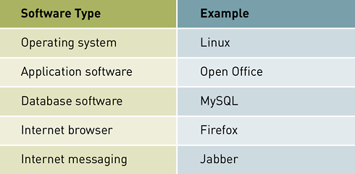
Open-Source Software (continued)
Table 4.10: Examples of Open-Source Software

Slide 40
Shareware, Freeware, and Public Domain Software
Shareware and freeware: software that is very inexpensive or free, but whose source code cannot be modified
Public domain software: shareware and freeware that is in the public domain

Slide 41
Software Upgrades
Software companies revise their programs and sell new versions periodically
Revised software may or may not offer any major additional capabilities
Revised software can contain bugs or errors
Software upgrades usually cost much less than the original purchase price

Slide 42
Global Software Support
Vendors face the challenge of providing adequate support for their software customers in all locations of the world
Trend of outsourcing global support to one or more third-party distributors

